Slide 1
InsideSherpa ANZ Virtual Internship
Task-1 Exploratory Data Analysis.

Slide 2
Introduction
This presentation contains the insights gained by performing EDA on the customer transaction data-set provided to me in the ANZ virtual internship on InsideSherpa. The link to the notebook where I worked on the data-set is given here.

Slide 3
Outline
Feature information.
Data cleaning
Insights about the features.

Slide 4
Feature description
There are a total of 23 features in the dataset.
There are 12043 data-entries.
The features are of various data-types such a int, float, data-time etc.
The features gives us various details about the customers and the merchants.
The information regarding the age, gender, location, account no., customer ID is given.
The information regarding the location of the merchant, merchant ID is given.
The type of transaction, transaction amount, brief description about the transaction, date of the transaction is given.

Slide 5
Data cleaning.
Certain features in the data did have missing values. Some of them had more than 90% missing values. These features were dropped in the beginning itself.
All the features having missing values were categorical features. So I imputed the missing values with a new category ‘Not available’.
All the imputed features had around 36% missing values.

Slide 6
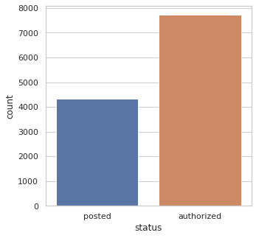
Univariate analysis.
In this section all the features were analysed on the no. of transactions.
Status
There were 2 entries in this feature, authorized and posted.
64% of the transactions were authorized and 36% were
posted.
Card_present_flag
36% missing values.
There are 2 entries, 1 & 0.
51% of transactions are 1 and 13% are 0.

Slide 7
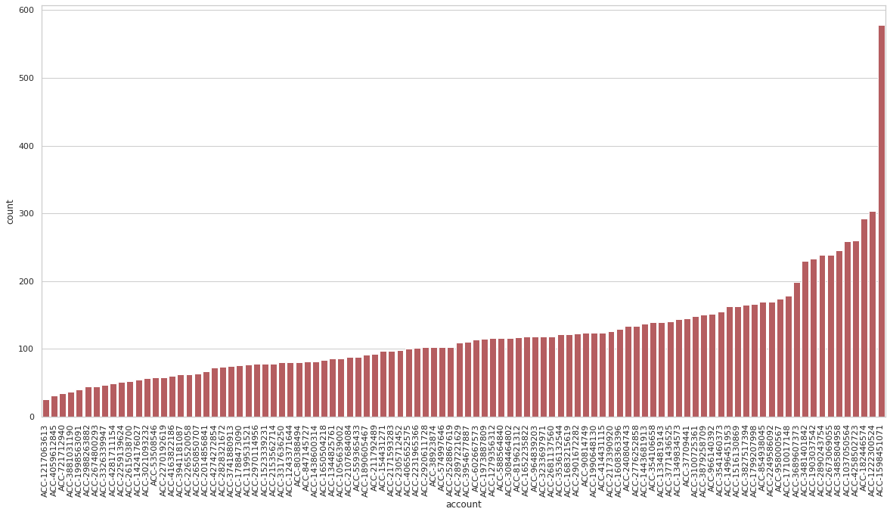
Account
100 unique accounts for 100 customers. Multiple transactions were done from all the accounts.
The max no. of transactions from a single account was 578(4%) and the min. was 25(0.2%).
Average no. of transactions from each account was 120. 90% accounts have less than 200 transactions.

Slide 8
Currency
There was only 1 entry, AUD. So we may as well drop the feature from the data-set as it of no use.
Long_lat
There were 100 unique locations. 100 unique locations for each of the acoounts. No 2 accounts have the same location.
The missing values in this features were denoted by an out of-bounds entry, 255.00 -573.00.
We could identify it as the latitudes range from -90 to 90 and longitudes range from -180 to 180. Also upon checking the corresponding
These values was replaced with ‘Not available’ as like before.
The remaining coordinates were plotted on a map. Most of the accounts were in Melbourne Sydney.
Rest were in Perth, Brisbane, Darwin and Adelaide.
Some were found in random spots all over Australia.

Slide 9
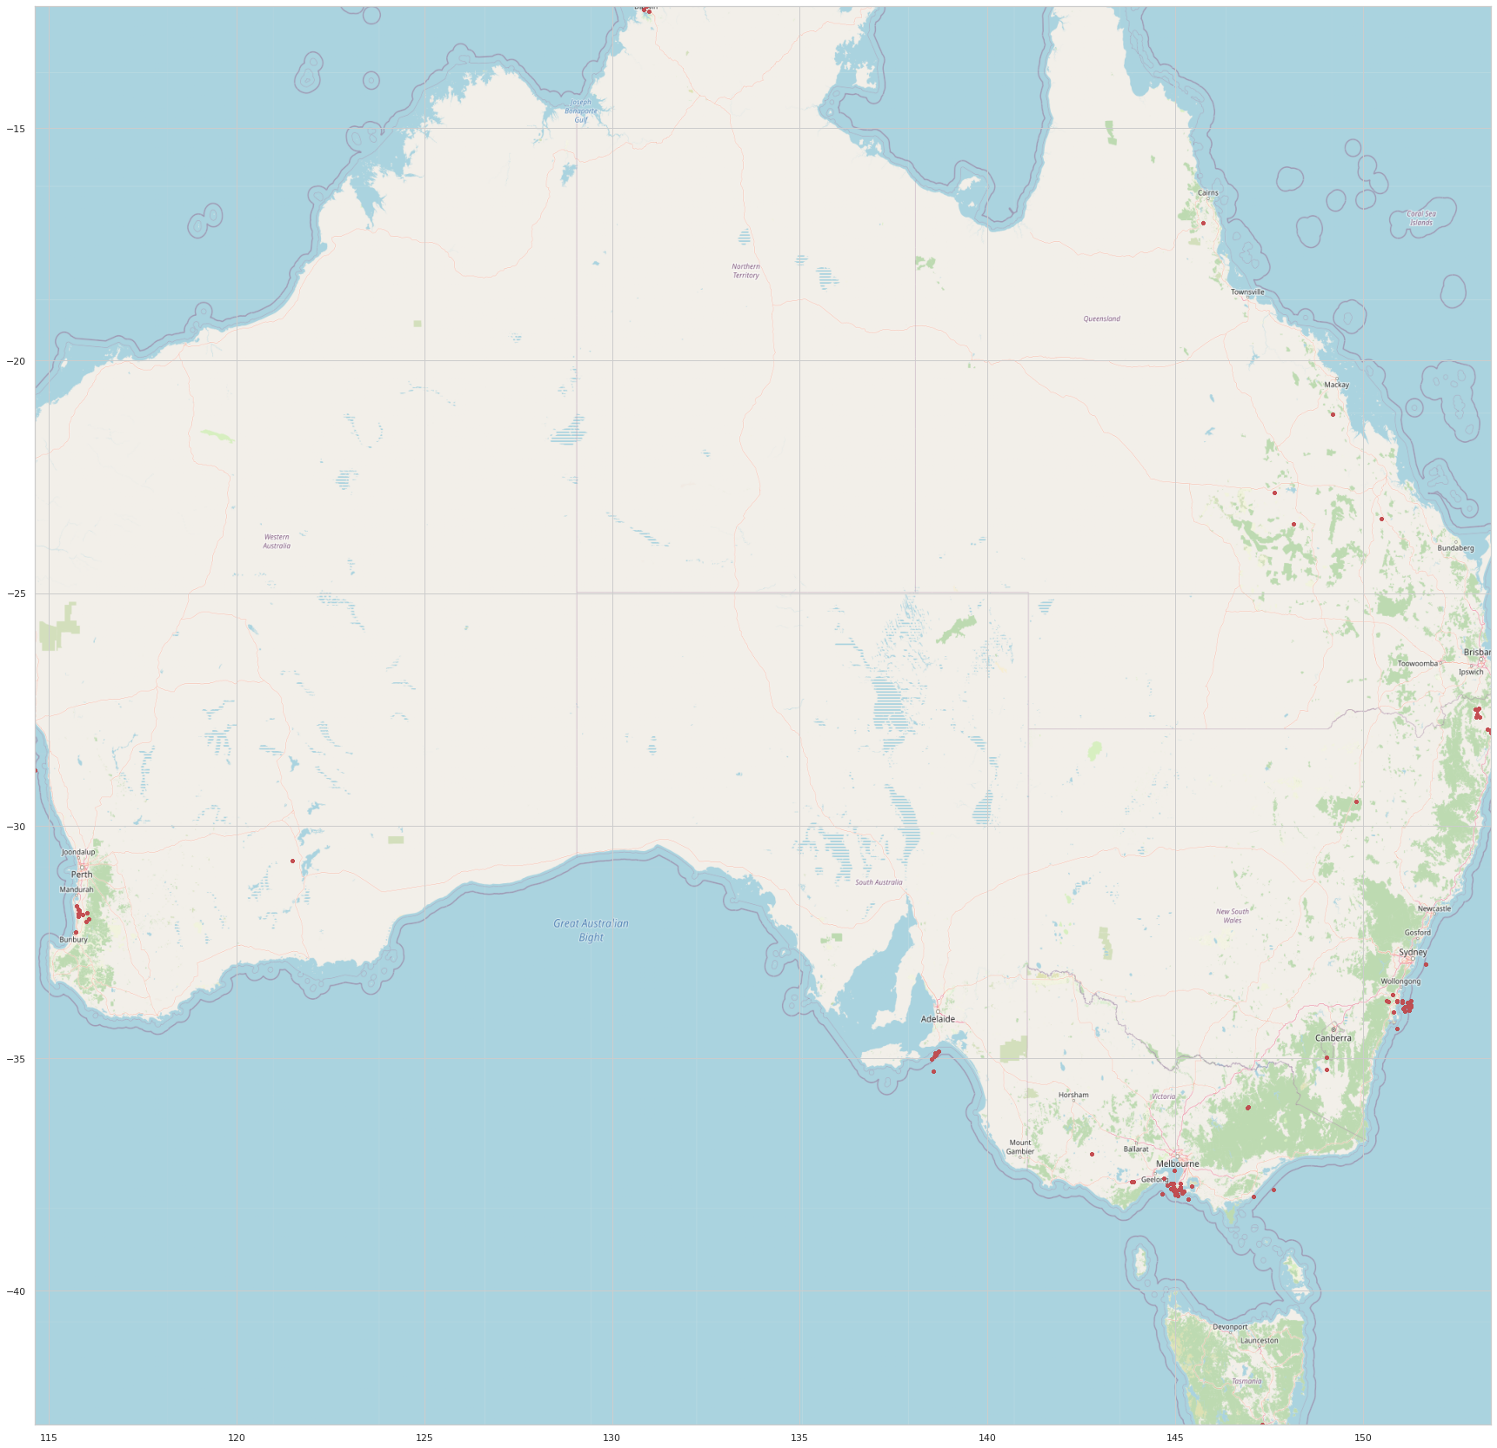

Slide 10
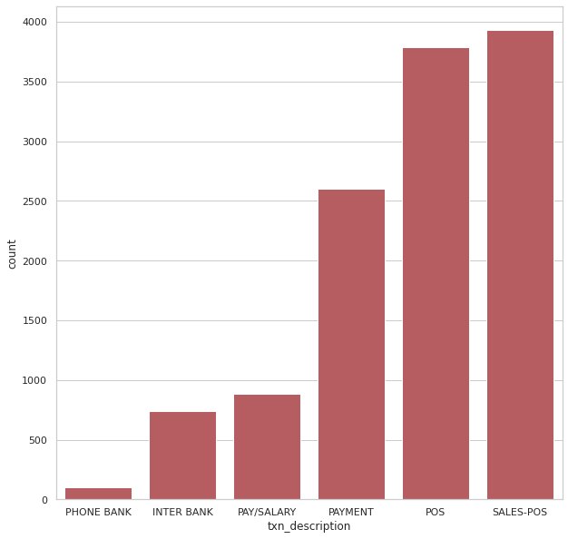
Txn_description
There were 6 unique entries in this feature.
Most of the transactions are labelled as ‘SALES-POS’(32.6%) and ‘POS’(31.4%).
The least no, of transactions are in ‘PHONE BANK’(0.8%).

Slide 11
Merchant_id
36% missing values.
5725 unique entries.
90% IDs were associated with less than 2 transactions. Maximum no. of transactions ina single ID is 14.
First_name
There were 80 unique first names.
Maximum no. of transaction were done by customers having their first name Michael(6%).

Slide 12
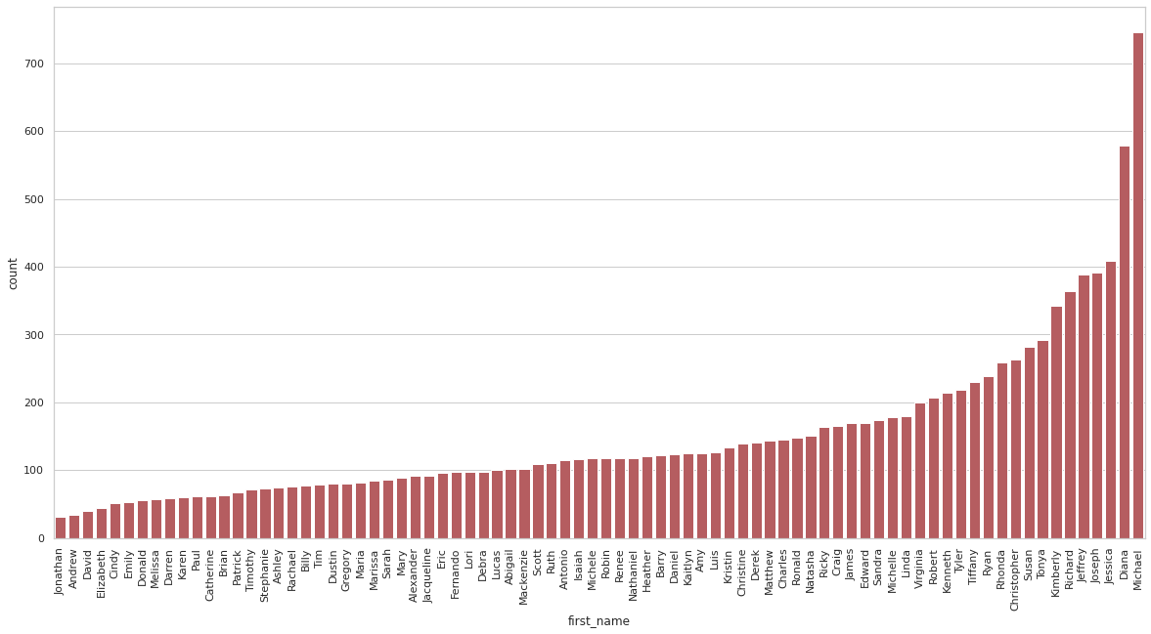

Slide 13
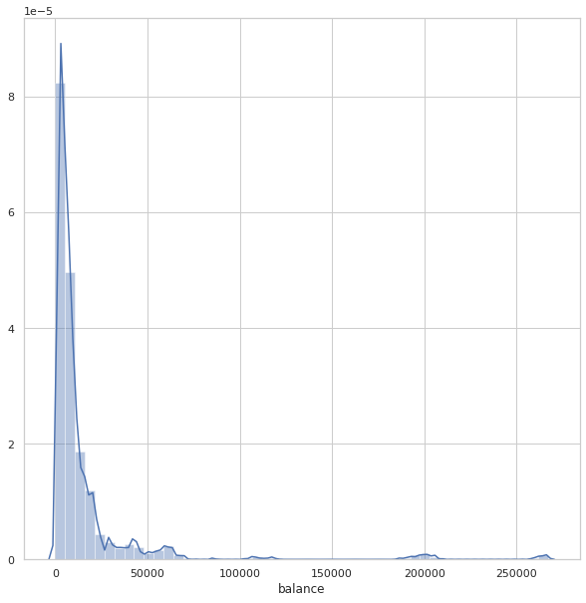
Balance
Most of the entries is between 0 and 25000.
Average balance is 14700.
Around 90% of entries are less than 29500.
The max. balance is 267128.52 and the min. is
0.24.

Slide 14
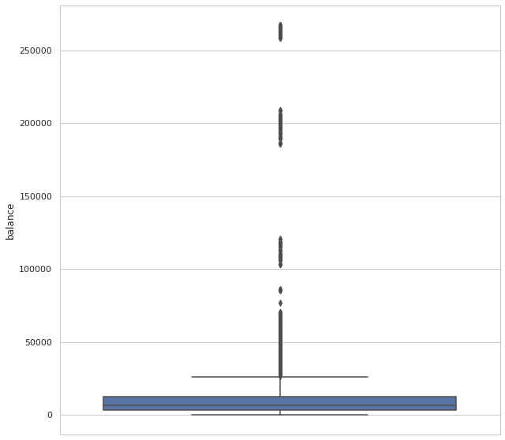
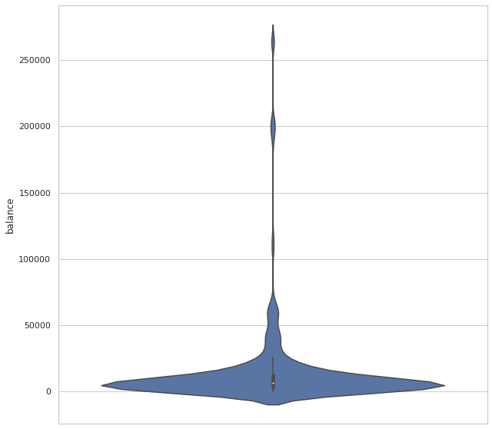

Slide 15
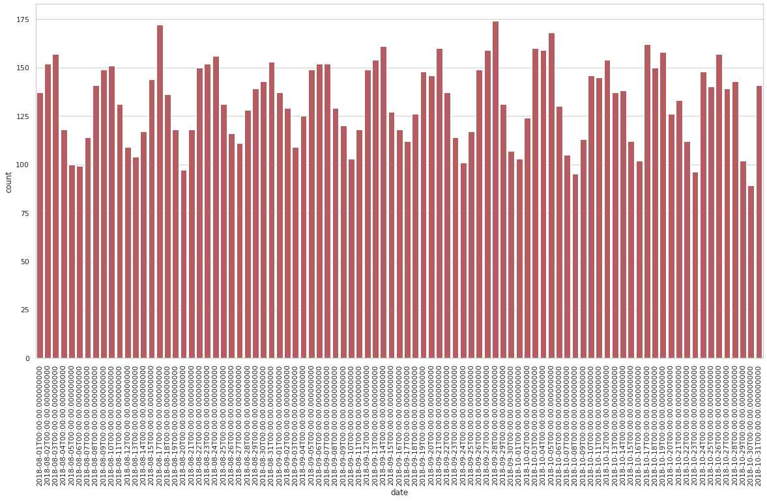
Date
Total duration is 91 days, from 01-08-2018 to 31-10-2018.

Slide 16
The max no. of transactions happened on 28-09-2018, 174 transactions(1.4%) and the min on 30-10-2018, 89 transactions(0.7%).
On an average 132 transactions occurred each day. 90% of the days had less than 158 transactions.
Dividing the entire data into three months, all the three months had almost equal no. of transactions(on an average 4013 transactions every month.
To be precise, the no. of transactions increased from 3943 to 4013(0.62%) in August-September and from 4013 to 4087(0.65%) in September-October.
Dividing the total transactions by the day of the week in which they occurred, max transactions occurred on Friday, 2073 transactions(17%) and minimum on Monday, 1360 transactions(12%).
Wednesday and Friday differ by only 10 transactions.

Slide 17
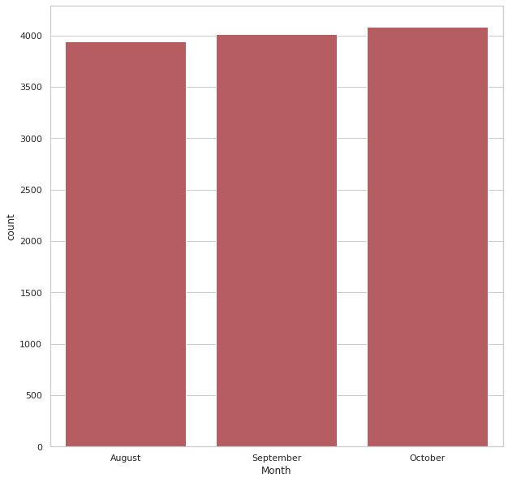
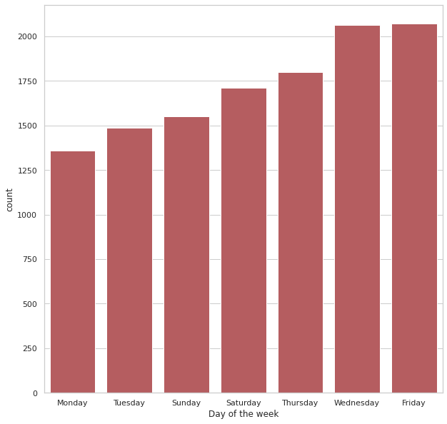

Slide 18
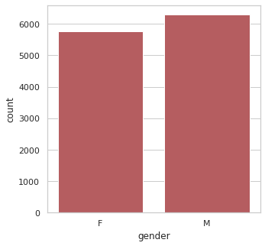
Gender
There are 2 entries, M and F.
An almost equal distribution between male and female customers, with 52% male and 48% female.

Slide 19
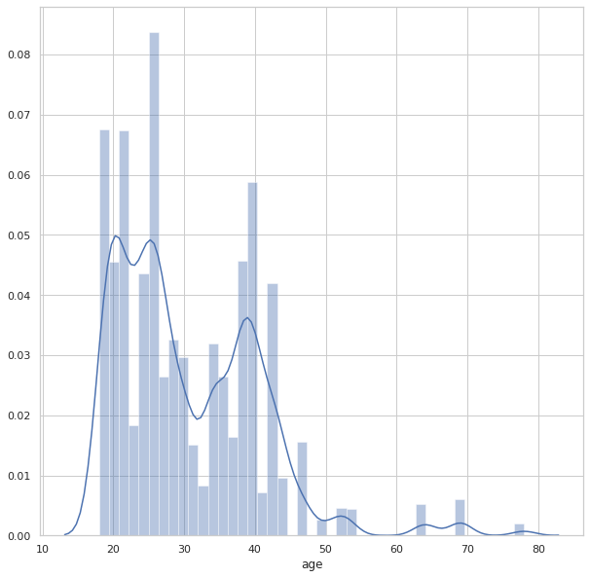
Age
Most of the customers are in the age-group of 20-35.
The oldest customer is 78 years old and the youngest 18 years.
The average age of customer is 18 years.

Slide 20
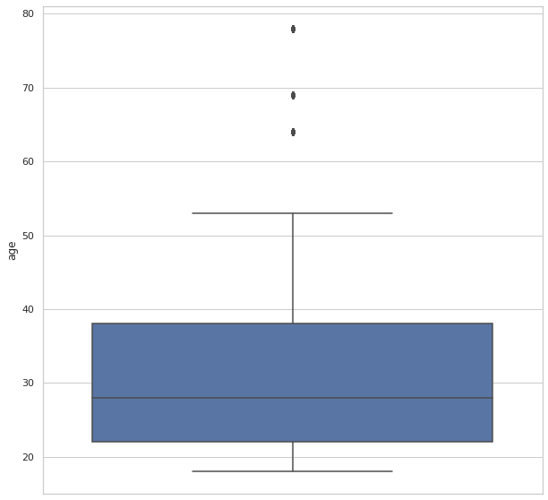
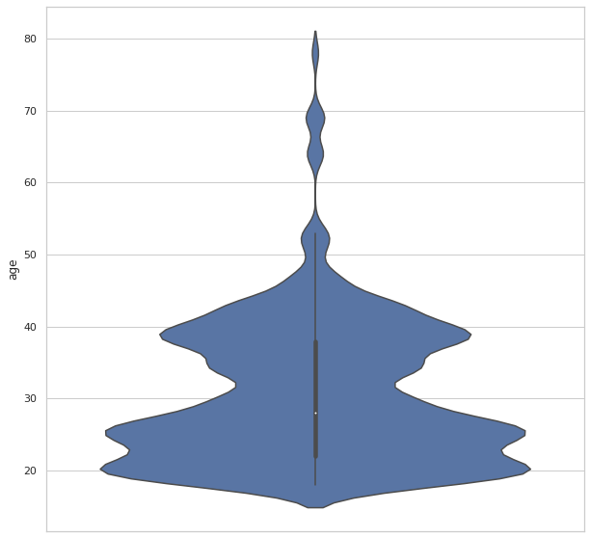

Slide 21
Merchant_suburb
36% missing values.
There are 1609 different suburbs. Most of the merchants are from Melbourne(2.1%) and then Sydney(1.9%).
Merchant_state
36% missing values.
There are 8 different states. Maximum merchants are from the state of New South Wales, 2169(18%) closely followed by Victoria, 2131(17.6%)
The min. no. of merchants are from Tasmania, 68(0.5%).

Slide 22
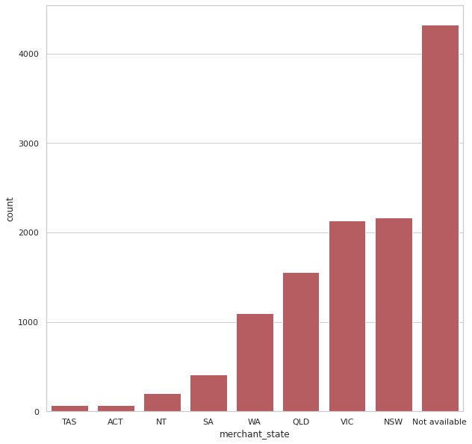

Slide 23
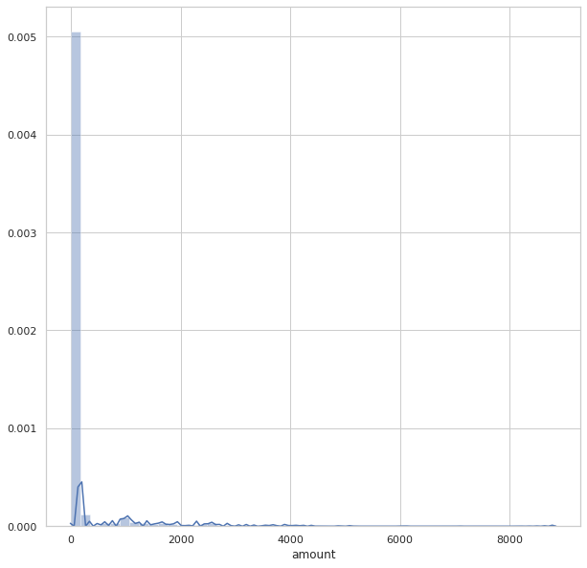
Amount
Most of the transaction amount is between 0-100 AUD.
The min. transactions amount is 0.1 AUD and the max. being 8836 AUD.
The average transaction amount is 29 AUD.
90% of the transactions is below 190 AUD.

Slide 24
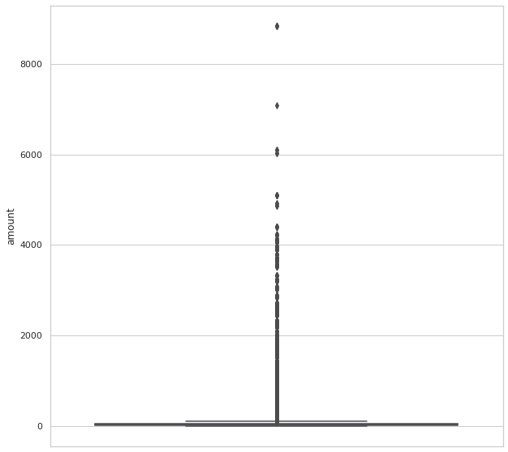
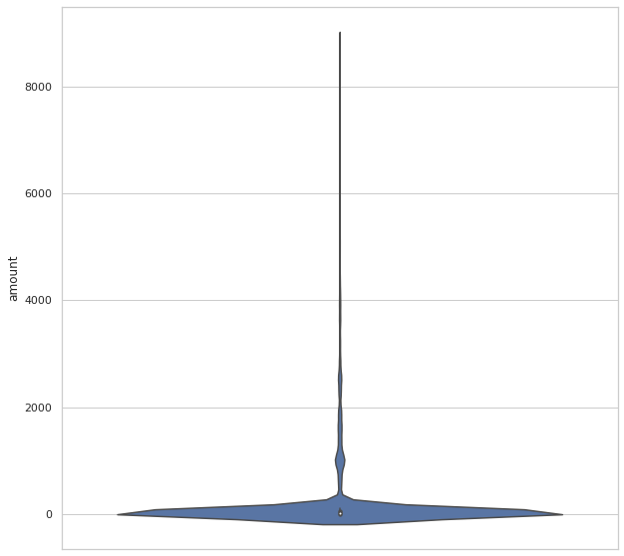

Slide 25
Transaction_id
There is a unique transacation_id for each transaction.
Country
There is only one entry(Australia) in it for all transactions, so we as well drop the feature.
Customer_id
There are 100 unique customer_id. Each account no. has a unique customer_id.
Same insights as of account.
Merchant_long_lat
36% missing data.
There are 2703 unique locations. There are multiple merchant_id associated with a single location.
These coordinated was then plotted on a map.
We could see that most of the merchants are based in and around Melbourne, Sydney, Brisbane, Perth, Adelaide.

Slide 26
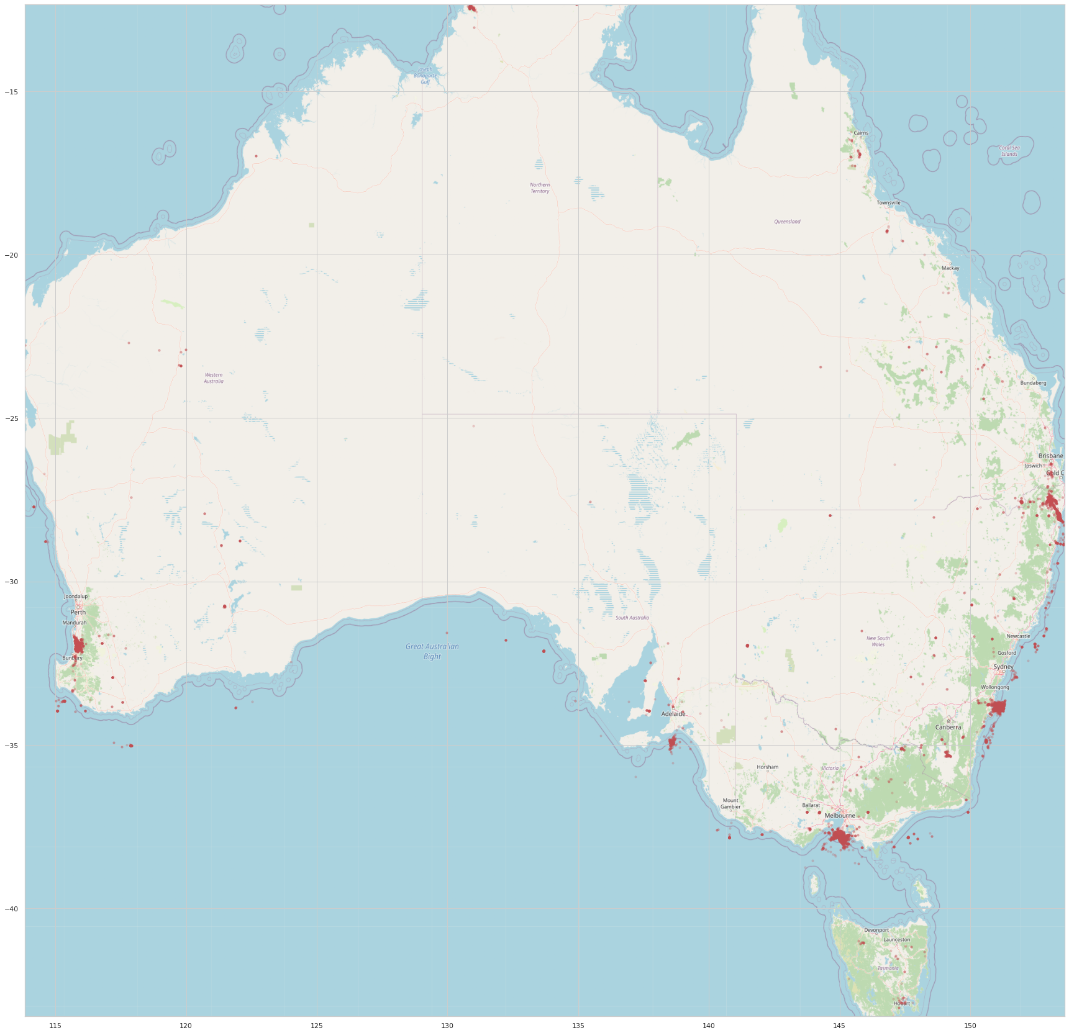

Slide 27
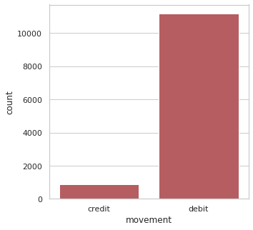
Movement
There are 2 entries in this feature, debit and credit.
11160 (93%) transactions are labelled as debit & 883 (7%) transactions as credit.

Slide 28
Transaction amount vs Month and Day.
Dividing the transaction on the month they happened, October has the highest transaction amount, and August the least.
The average transaction amount in each month is highest in October and lowest in September.
Dividing the transactions on the day they happened, Friday has the highest transaction amount, and Sunday the least.
Even though the Monday had the least no, of transactions, the total transaction amount on Mondays is close to Friday.
The average transaction amount is the highest on Monday and least on Sunday.

Slide 29
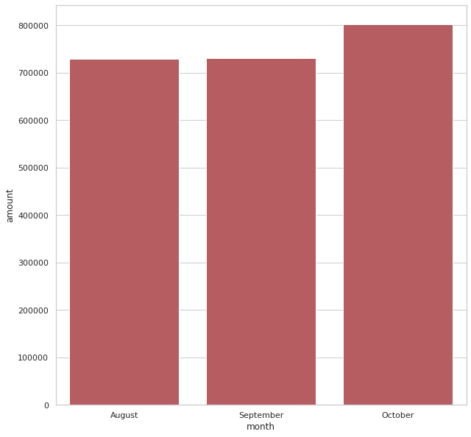
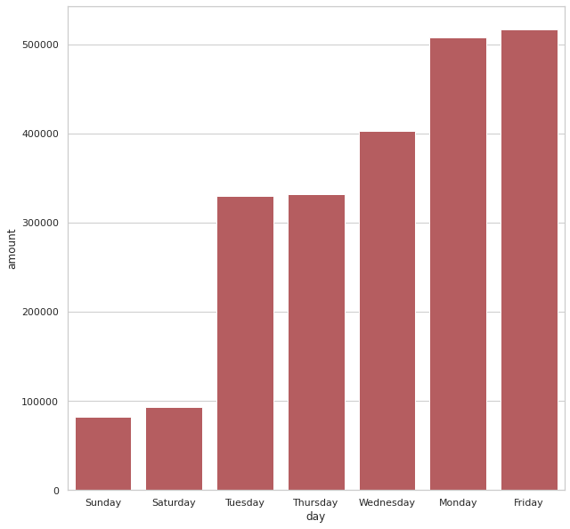

Slide 30
Contact me
LinkedIn https://www.linkedin.com/in/gokul-s-kumar
Email skumar.gokul@gmail.com
Phone +91 8921953774

